Slide 1


Bad Data, Bad Decisions: AI in Harsh Environments
Sensor failures, weather interference, and unreliable field data

Slide 2
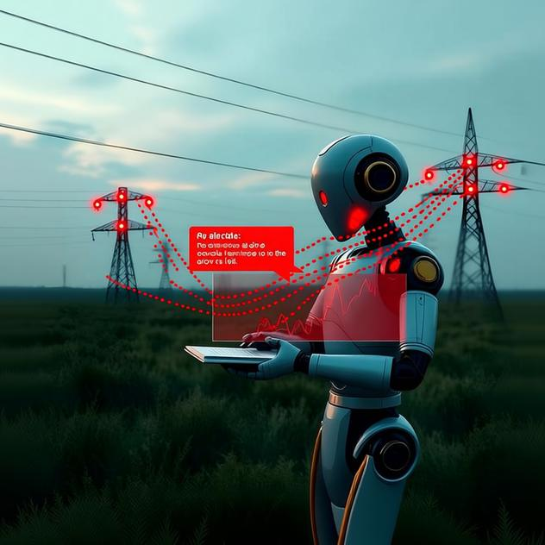
Bad Data, Bad Decisions: AI in Harsh Environments
Bad Data, Bad Decisions
How AI fails when data does
AI needs data to work
Bad data breaks AI
Sensors fail in the field
Weather corrupts readings
Garbage in, garbage out

Slide 3
Bad Data, Bad Decisions: AI in Harsh Environments
Common Sensor Failure Modes
How sensors break down in harsh conditions
Drift: readings slowly shift over time
Signal noise from electrical interference
Complete dropouts and communication loss
Physical damage from weather and vibration
Harsh conditions accelerate all failures

Slide 4

Bad Data, Bad Decisions: AI in Harsh Environments
AI's Blind Trust Problem
Why AI can't detect bad data on its own
AI accepts all sensor input as valid
No built-in quality checks
Cannot distinguish real from corrupted signals
Trained on clean lab data, not messy field conditions
Missing context to question unrealistic readings

Slide 5
Bad Data, Bad Decisions: AI in Harsh Environments
Weather Interference Effects
How environmental conditions corrupt field data
Rain and moisture cause electrical faults
Temperature extremes affect sensor accuracy
Wind and vibration create false readings
Dust and debris block or damage sensors
Electromagnetic storms disrupt wireless signals

Slide 6

Bad Data, Bad Decisions: AI in Harsh Environments
The Cascade Effect
How single corrupted signals spread through systems
One faulty sensor affects thousands of data points
Bad readings train models incorrectly
Predictions drift silently in wrong direction
Small errors compound into major mistakes
Problem often unnoticed until damage is done
Your gut feeling that something is off

Slide 7

Bad Data, Bad Decisions: AI in Harsh Environments
Prevention Strategies
Cross-check readings from multiple sensors
Apply smoothing to filter sudden spikes
Install redundant sensors as backup
Train AI on degraded data scenarios
Building resilience against data corruption
Set confidence thresholds for uncertain outputs

Slide 8

Bad Data, Bad Decisions: AI in Harsh Environments
Recovery and Cleanup
Restoring integrity after corruption occurs
Identify
Identify corrupted data sources first
Use
Use backup streams to fill gaps
Flag
Flag suspect records, don't delete them
Retrain
Retrain models on cleaned datasets
Document
Document all recovery steps thoroughly

Slide 9
Bad Data, Bad Decisions: AI in Harsh Environments
Key Takeaways
Always question your data sources
Context matters more than raw numbers
Build in human oversight points
Start small and verify before scaling
Plan for sensor failures from day one
Essential principles for reliable AI in harsh environments

